Slide 1
Android PHP from MySQL
Arc Chang
2016/08/17

Slide 2
Outline
Introduction
Volley – Http Request Framework
Implement
Read
Insert
Update
Delete
Special case
Image
Array
Example
Reference

Slide 3
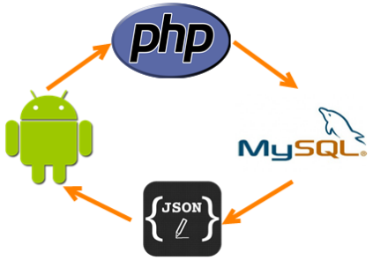
Introduction
For Android SQLite database, we can handle the table easily
But it can’t share with other applications
So we should use our local or cloud databases
In order to access them,
1. Write PHP code
Implement GET or POST method
Change MySQL database’s data into JSON format

Slide 4

2. Use Android Library to handle the GET or POST request
HttpClient
Was removed at Android 6.0
https://developer.android.com/about/versions/marshmallow/android-6.0-changes.html#behavior-apache-http-client
HttpURLConnection
Has some bugs before Android 2.2
Can’t be used in Main Thread
Volley
Bad in large data transmission
Easy to use!

Slide 5

Volley
At Google I/O 2013
Volley: Easy, Fast Networking for Android
Developer Ficus Kirkpatrick
Volley, a library that makes it really easy to build super-fast networked applications for Android

Slide 6
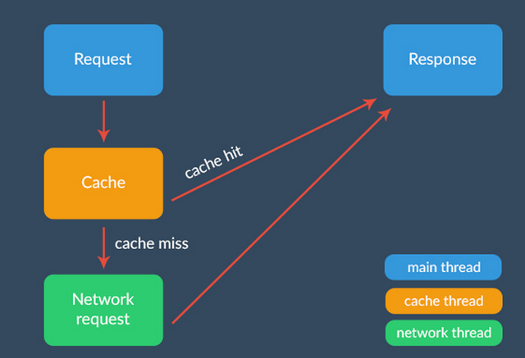
Framework
To see more details, click the link below the image
From：http://code.tutsplus.com/tutorials/an-introduction-to-volley--cms-23800

Slide 7
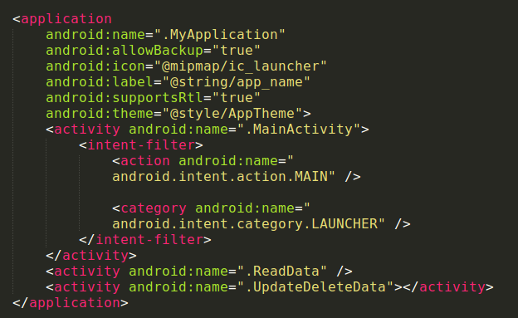
Implement
Gradle
compile 'com.mcxiaoke.volley:library:1.0.19'
AndroidManifest.xml
<uses-permission android:name="android.permission.CHANGE_NETWORK_STATE" />
<uses-permission android:name="android.permission.INTERNET" />
Add an Application class
In order to make all
activities used the
global variables

Slide 8
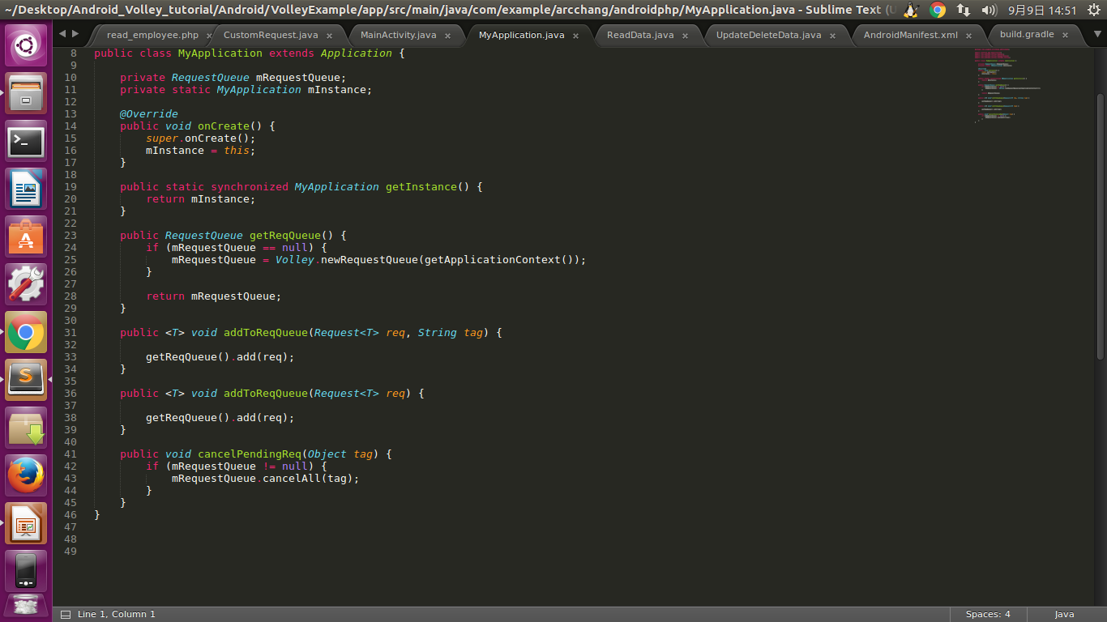
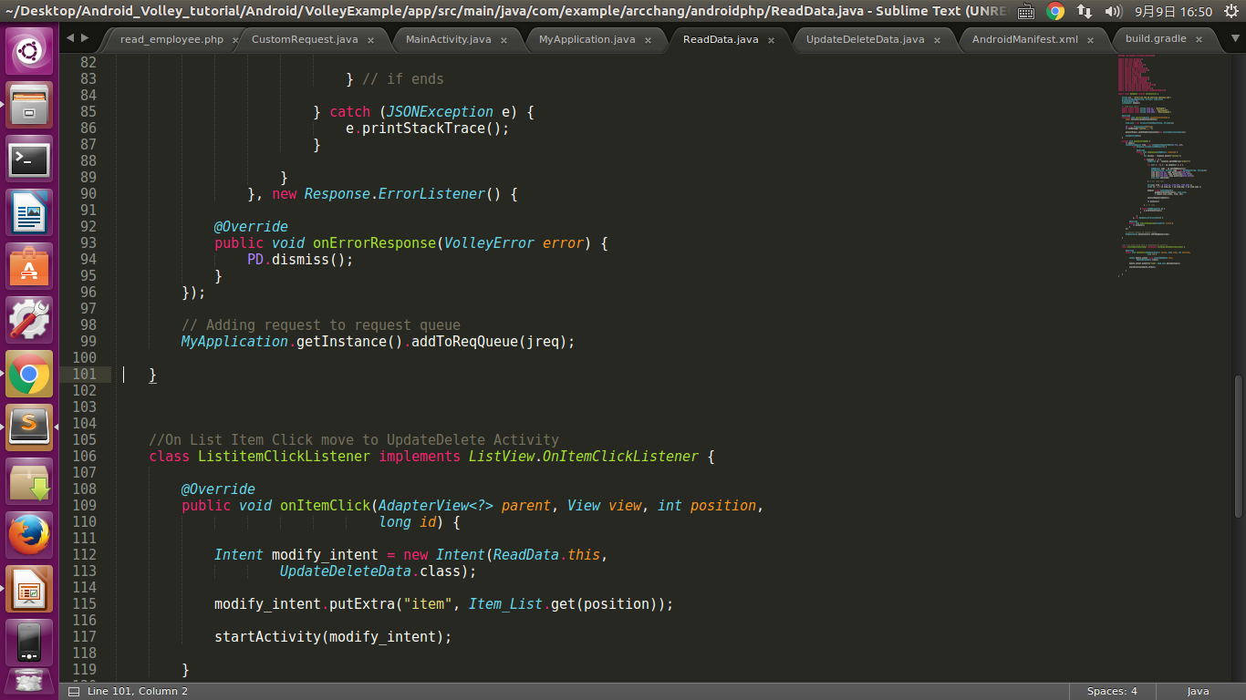
MyApplication.java
Step to use Volley
1. New a RequestQueue
2. New a request
String
JSONObject
Image
3. Add request to
RequestQueue

Slide 9
PHP functions
mysqli_connect( ): open a new connection to the MySQL server
mysqli_query( ): performs a query on the database
mysqli_num_rows( ): gets the number of rows in a result
mysqli_fetch_array( ): fetch a result row as an associative, a numeric array, or both
mysqli_affected_rows( ): gets the number of affected rows in a previous MySQL operation
json_encode( ): returns the JSON representation of a value
isset( ): determine if a variable is set and is not NULL
empty( ): determine whether a variable is empty
Steps to write PHP
Connect → Query → Handle return values
→ JSON encode

Slide 10
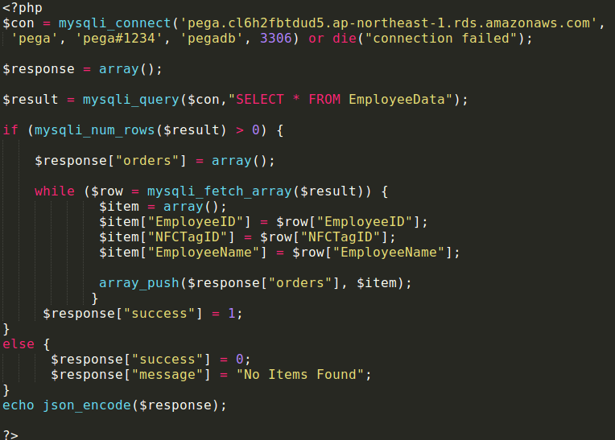
Implement – Read
PHP
read_employee.php

Slide 11
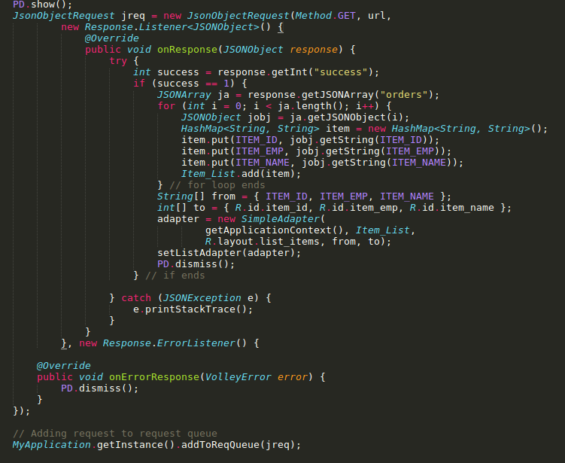
Android
ReadData.java

Slide 12
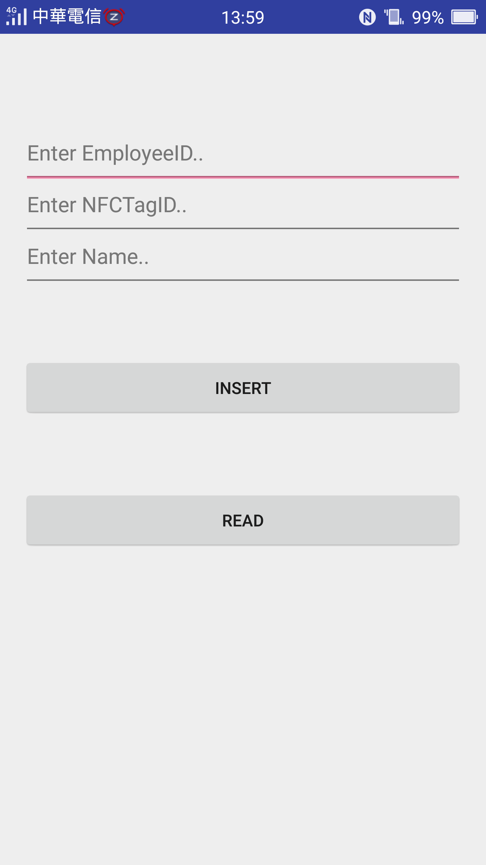
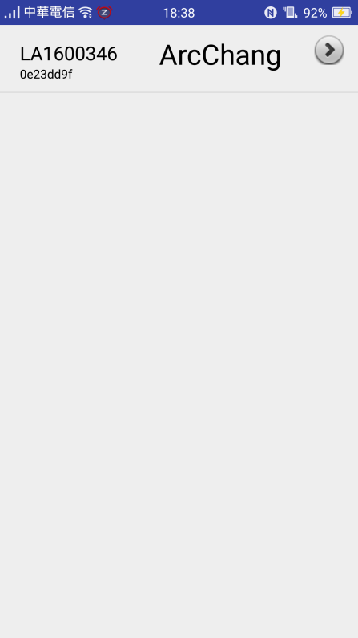
Demo

Slide 13
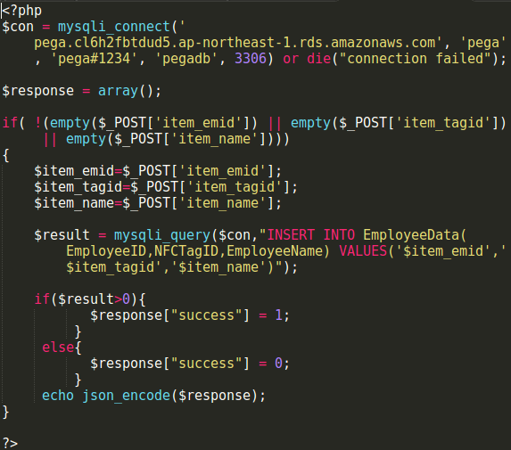
Implement – Insert
PHP
insert_man.php

Slide 14
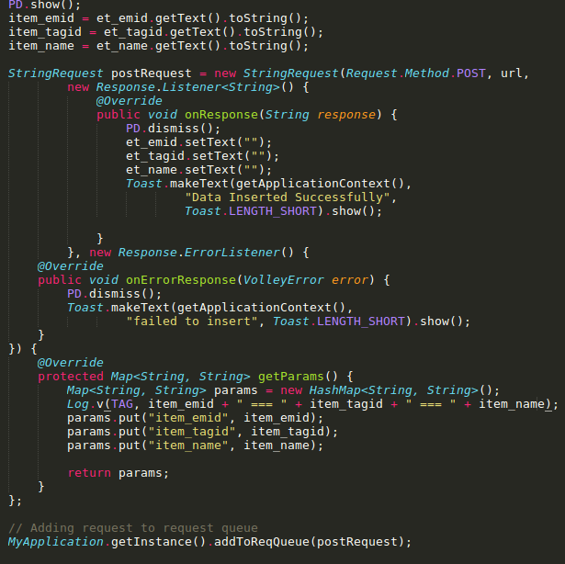
Android
MainActivity.java

Slide 15
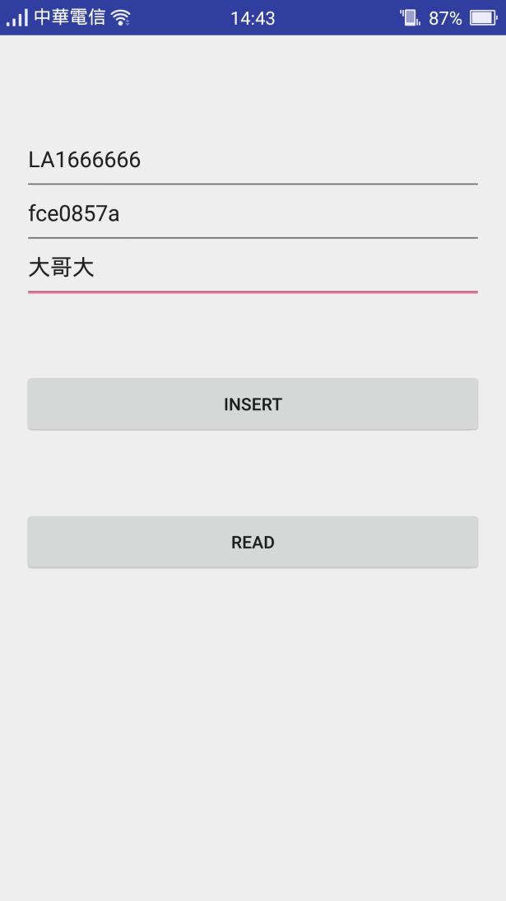
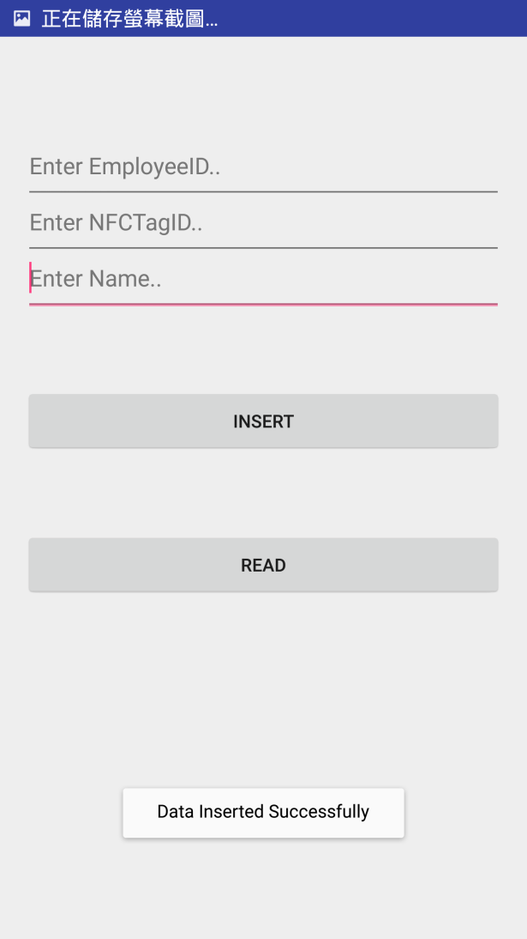
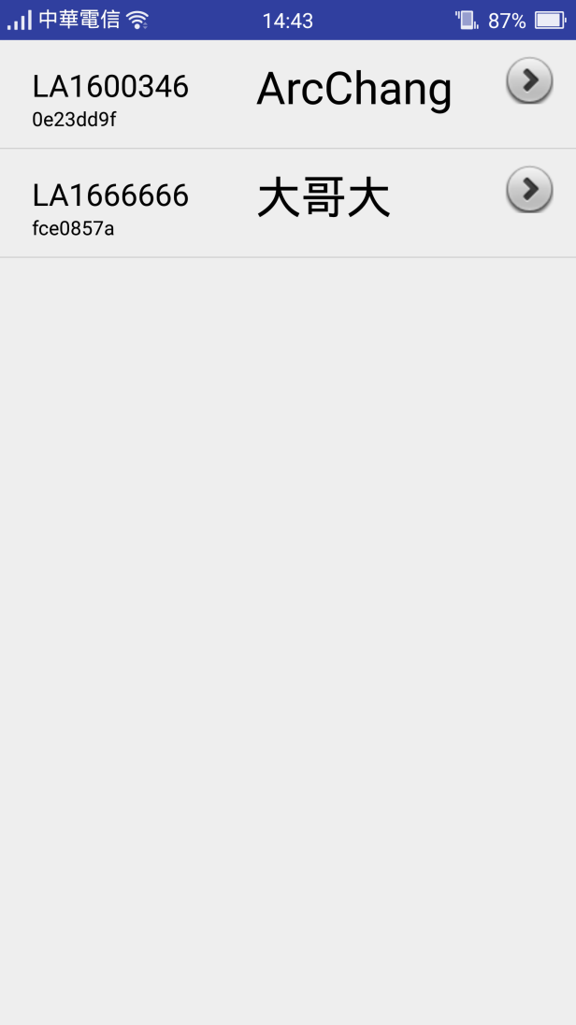
Demo

Slide 16
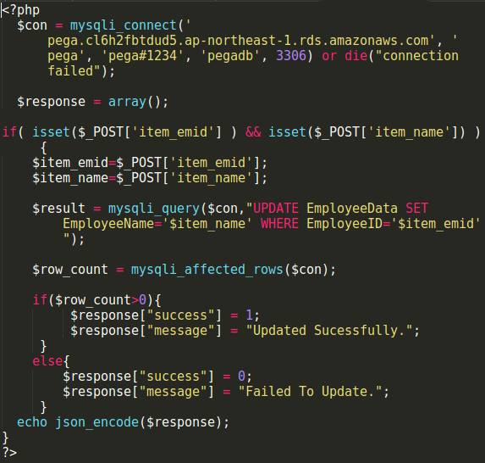
Implement – Update
PHP
update.php

Slide 17
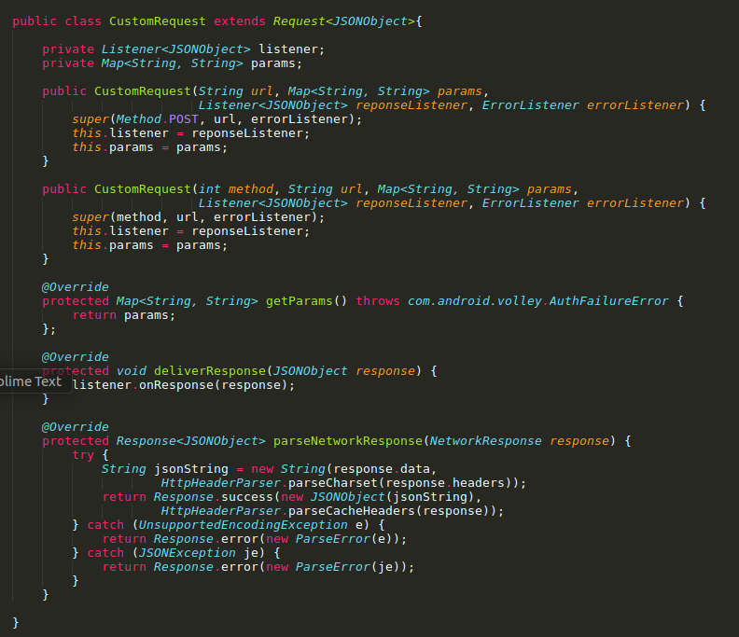
Android
We can write a CustomRequest class to handle the request

Slide 18
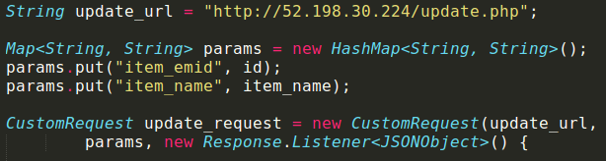
For above pattern, It’s easy to control the params
Other parts are same as mentioned previously

Slide 19
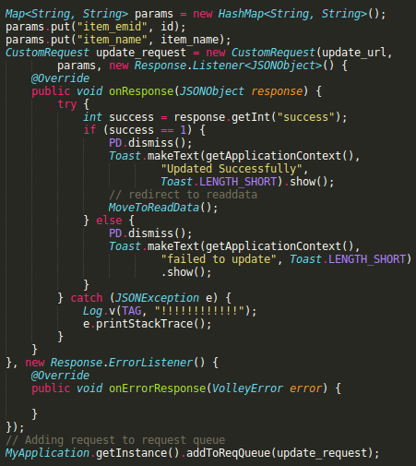
UpdateDeleteData.java

Slide 20
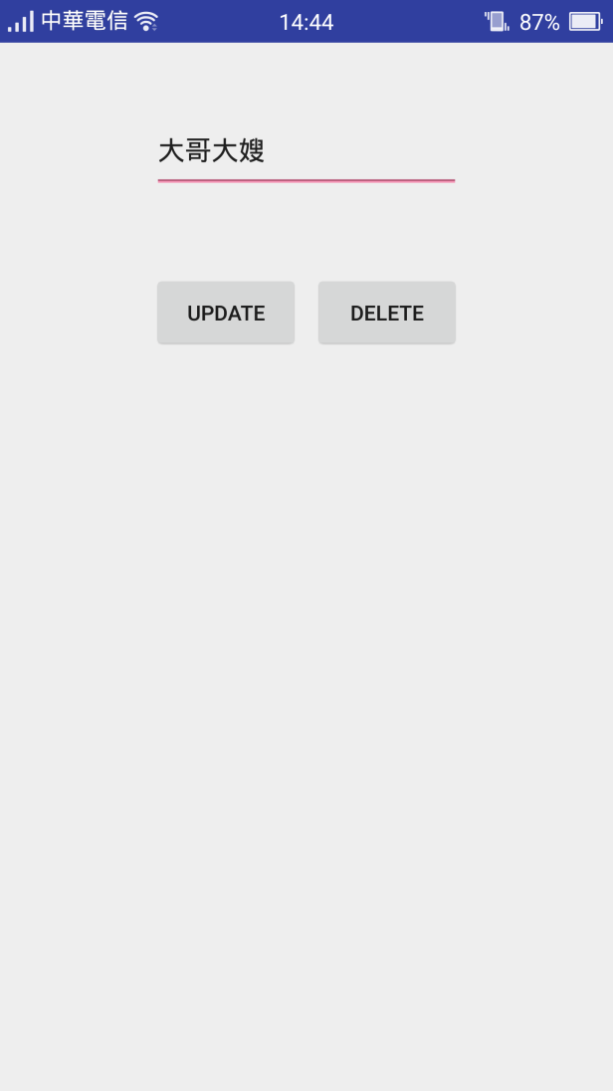
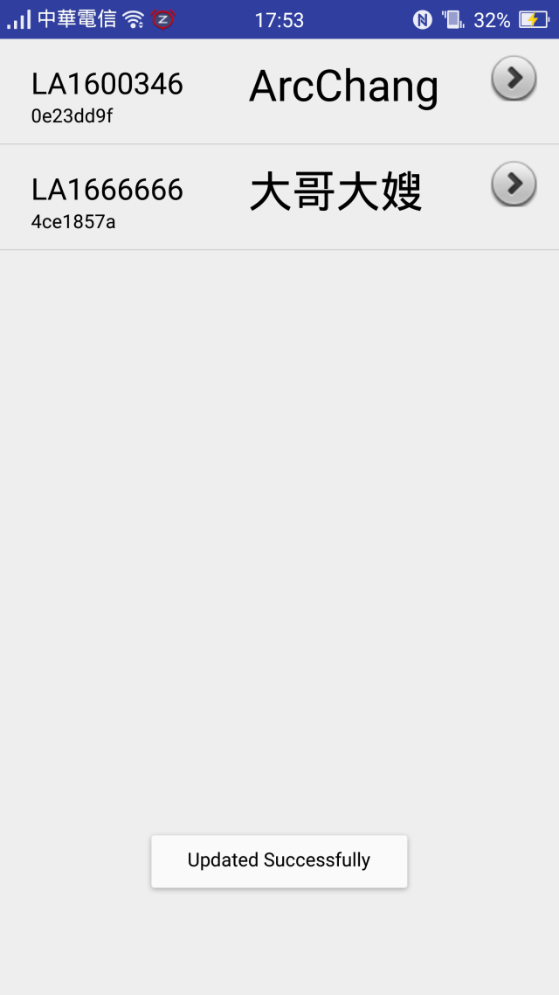
Demo

Slide 21
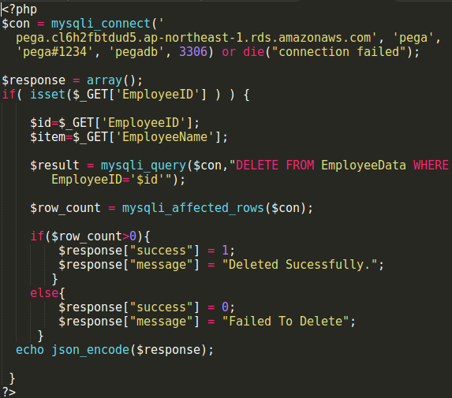
Implement – Delete
PHP
delete.php

Slide 22
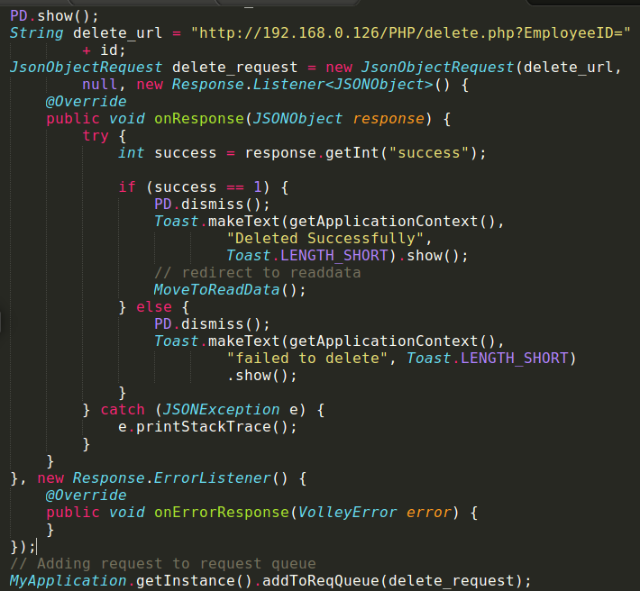
Android
UpdateDeleteData.java

Slide 23
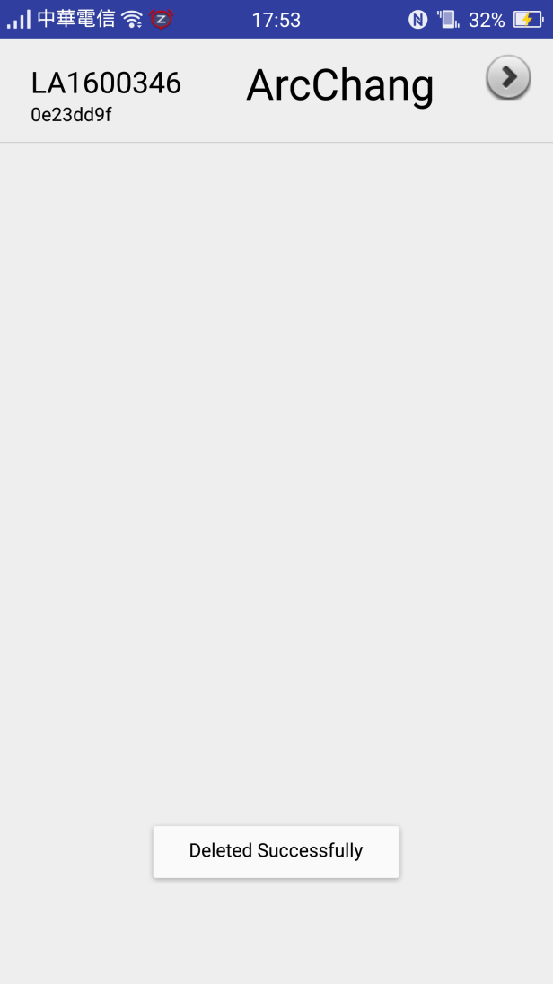
Demo

Slide 24
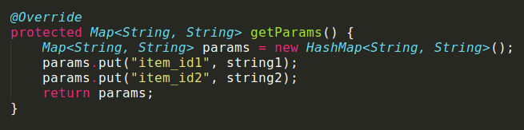
Special case
We can use JsonObjectRequest to upload JSON format data to our database
However, cause we need to connect the database through POST request
Volley provides getParams() method to implement
And the type is String only
Thus, we must change any type of data into “String”

Slide 25
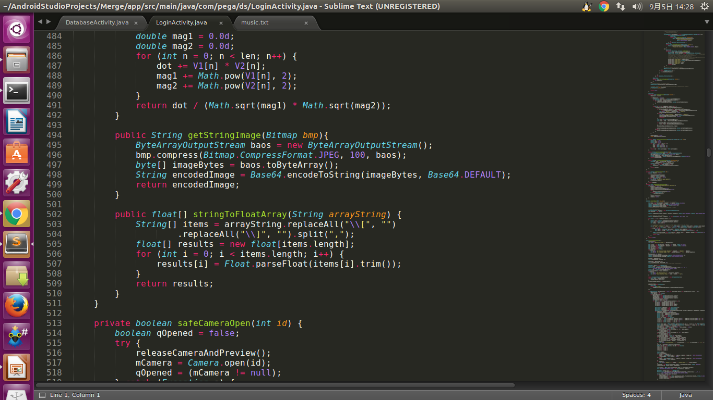
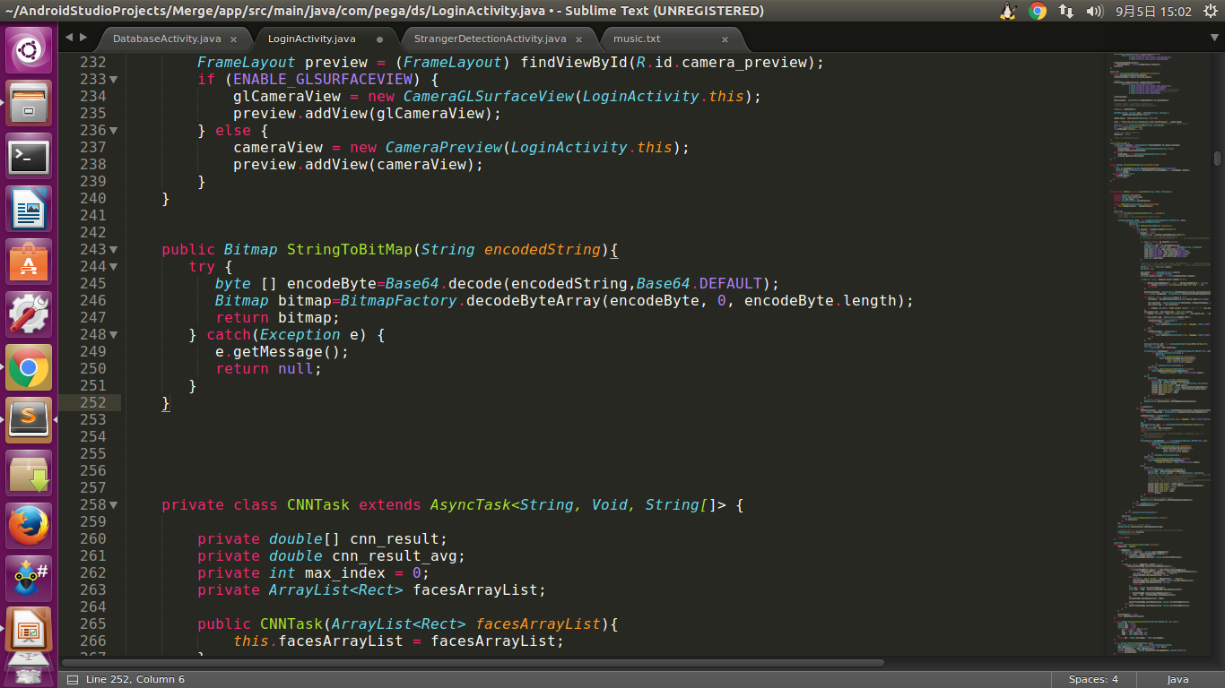
Special case – Image
For Bitmap to String
Compress bitmap first and then change into byte[ ]
Use Base64 to encode the byte[ ] to String
For String to Bitmap
vice versa

Slide 26
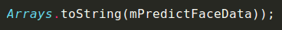
Special case – Array
For array to String
If float[] mPredictFaceData = {4.8, 5.2, 0, 6.5};
We will get String ans = [4.8, 5.2, 0, 6.5];
For String to array
Split the String first
Then use parse to change type of data one by one

Slide 27

Example
GO to my GitHub and git clone the repository
Android_Volley_tutorial
https://github.com/arcprince1236/Android_Volley_tutorial

Slide 28
Reference
https://blog.ccjeng.com/2015/08/Android-Volley.html
http://in.gururu.tw/2013/09/Volley-HTTP-Library-for-Android.html
Image
http://stackoverflow.com/questions/13562429/how-many-ways-to-convert-bitmap-to-string-and-vice-versa
String
http://www.ewdna.com/2012/02/javaarray-to-string-string-to-array.html
http://code.tutsplus.com/tutorials/an-introduction-to-volley--cms-23800

Slide 29

Thanks

